Slide 1

Microsoft Partner Update
Microsoft EU, Norway & UK
FX Adjustment
Securing the Partner Ecosystem
Christian Moser,
Microsoft Western Europe
Microsoft Confidential – For partners only

Slide 2

Microsoft Briefing to Channel Partners Commercial FX Pricing Strategy for Euro (EUR), Swedish Krona (SEK), Norwegian Krone (NOK), Danish Krone (DKK) and the British Pound (GBP)
Please hold your questions until the Q&A part
Microsoft Confidential – For partners only

Slide 3
Important Update from Microsoft Europe and UK
The information in this presentation is intended for Microsoft channel partners only.
Microsoft requests partners to not tweet, blog, or post this information on their website or social media sites.
We request you to not publicize this information.
For additional clarification, contact your PDM.
Microsoft Confidential – For partners only

Slide 4
Commercial Pricing Update for EU, Norway and the UK
What is Microsoft announcing ?
Today Microsoft is announcing several steps to ensure greater price harmonization for our cloud products across the globe. This will ensure that all our customers worldwide have more closely aligned pricing compared to the USD rate.
That is why on April 1, 2023, we will adjust Microsoft Cloud prices in EUR, GBP, SEK, NOK, DKK to adjust for local currency fluctuations and move towards more consistent global pricing.
We believe that our cloud continues to be priced competitively. We also believe that it enables customers to do more with less by enabling them to innovate, to consolidate and to eliminate operating costs, optimize business performance, and build a foundation for a strong security strategy.
  How much will prices change?
  What prices are impacted?
  What prices are NOT impacted?
  Swedish Krona (SEK) prices will adjust 15%
  Danish Krone (DKK), Euro (EUR) and Norwegian Krone (NOK), prices will
  adjust 11%
  British Pound (GBP) prices will adjust 9%
  New or renewing Microsoft Cloud license program contracts will adjust to the new revised prices starting April 1, 2023. For business customers, these changes will not affect existing orders under commercial licensing agreements for products that are subject to price protection.
  Azure in Microsoft Customer Agreement will not be affected due to US dollar pricing with monthly updated billing FX rates.
  On-premise pricing, consumer prices, hardware, and OEM are not covered by this announcement.
  For indirect sales, final prices and currency
  of sale will continue to be determined by resellers.
Microsoft Confidential – For partners only

Slide 5
What licensing programs will be affected?
Not Affected | Affected
Hardware; anything on premise SW Windows Server, Exchange, Office 2021… SPLA CSP SW subscriptions and perpetual licenses Anything Azure already on New Commerce Azure Plan, Modern licensing, MCA-E, MACC: These are already following a monthly FX adjustment rhythm (since Novemer 2020) Includes Azure Savings Plan, Azure Reserved Instances, etc… | Seat-based commercial cloud services (MW, Dynamics, Power Platform), independent of License motion (CSP, EA, MCA-E, Online Credit Card billings, Open Value, Edu/Campus agreements…), Customer Type (Commercial, Edu, Charity, Public Sector) Legacy Azure (EAs, old Online Credit Card, CSP Legacy)
All agreements with a prices lock, signed before, until they renew after April 1st | All new & renewed subscriptions/contracts signed on or after April 1st, 2023
Microsoft Confidential – For partners only

Slide 6
What licensing programs will be affected?
Licensing Programs In Scope
NEW & RENEWING customers Unified price adjustment approach for all categories of customers (including Commercial, Government and Academic.)
Commercial cloud services sold through Enterprise Agreement (including EA Desktop Enrollment, EA Subscription Enrollment + Server and Cloud Enrollment) Microsoft Customer Agreement (MCA) Cloud Solution Provider program Microsoft Online Subscription Program (web-direct) Microsoft Products and Services Agreement Open Value Open Value Subscription EES/School/Education/Campus agreements
EXISTING customers and price protection benefit Mid-term commercial licensing agreements have price protection on previously ordered products. No price change during their agreement term on those products* From April 1, 2023 any new products ordered will be priced at the current pricelist prices Azure (ACD) Price Lock Details Azure Commitment Discount (ACD) is a fixed discount, customers will continue to receive the discount percentage specified in the contract. ACD has no impact on the baseline price. The fixed discount will be applied to the current month’s EA list price, customers will see their price increase but not above their baseline price protection or SKU price lock
* See appendix for details
Microsoft Confidential – For partners only

Slide 7
Impact by Licensing Program

Slide 8
Impact by licensing program
Scenario | Pricing Update Impact
Existing EA/EAS or SCE customers | Price protection on previously ordered products. No price change during the term of the agreement. New product additions will be priced using the current price list.
OV | Company-wide Existing OV and OVS company-wide contracts have price protection and will not experience a price change during the term of their agreement. New products will be priced using the pricelist at the time of order. Non-companywide For OV non-company-wide purchases there is no price protection. New orders will be priced using the pricelist at the time of order.
SPLA | Not in scope/Not impacted as no On-Prem changes.
CSP | Azure and Seat-based offers in legacy CSP and Seat-based offers in new commerce are impacted by the April 1, 2023 pricing adjustment. Azure in new commerce CSP is in USD and is not impacted
Direct/MOSP | Existing MOSP customers with an annual commitment receive price protection during their term. Adding seats to an existing subscription after April 1, 2023 will be at the previous billing price which remains in place for the remaining twelve-month term purchased before April 1, 2023. Renewals will be subject to the then current prices. No contract or pay-as-you-go: Mostly Azure and some O365. New prices apply starting April 1, 2023.
Microsoft Confidential – For partners only

Slide 9
Timeline and Resources

Slide 10
EU, Norway and UK Commercial FX
Phase I
Global Announcement
Phase II
Internal & Partner Disclosures
Phase III
New Price List Preview
Phase IV
New Price List Live
October to January
January-February 2023
March 2023
April 2023
Global Announcement
New Semi-Annual FX Cadence
October 31, 2022
Internal Memo
and Briefing
January 4th, 2023
Partner Price
List preview
(No preview for Azure)
Revised FX Prices Effective
External Partner Announcement Email & Briefing
January 5th, 2023 9:00am CET
Azure subscriber
e-mail
Buy Now
Opportunity to engage customers and partners to help them prepare
Buy Now
Opportunity to engage customers and partners to help them prepare
Business As-Usual
Inform and mitigate as needed
Ongoing Customer and Partner engagement Rhythm
Microsoft Confidential – For partners only
Notes:
What is the eventual outcome and impact?
Then additional constraints

Slide 11
Channel Resources available
Please use the following resources to prepare and engage with your Resellers and Customers
Partner Community Calls Office hours for Partners​​: Microsoft FX rate adjustments and upcoming security changes for CSP Partners – Belgium Cloud Champion Partner & Customer resources Partner Center (CSP): January 2023 announcements - Partner Center | Microsoft Learn Ops Gallery (LSP/all partners): Collection (microsoft.com) Escalations Contact your Partner Development Manager (PDM) Follow the normal process if additional help is needed

Slide 12
Cmoser Addendum
Sales Scenarios for CSP – Partners
  CSP Legacy
  CSP NCE

Slide 13
CSP Legacy subscriptions scenarios
Feb 22 | Mar 22 | Apr 22 | May 22 | Jun 22 | … | Dec 22 | Jan 23 | Feb 23 | Mar 23 | Apr 23 | May 23 | Jun 23 | Jul 23 | Aug 23 | …
CSP Legacy subscription I
Renew CSP legacy subscription I to lock in FX rate for 12 months*
CSP Legacy subscription II
CSP Legacy subscription II, new FX rate applied
Cancel CSP Sub II, create a new CSP NCE subscription
Price at creation of subscription locks in price for subscription terms (12 months).
Adding more seats later is possible for the same price.
CSP Legacy subscriptions by default 12 months
you cannot create new CSP legacy subscriptions since March 2022.
*No incentives paid on CSP legacy subscriptions as of Jan 1st, 2023

Slide 14
CSP NCE subscriptions scenarios
Feb 22 | Mar 22 | Apr 22 | May 22 | Jun 22 | … | Dec 22 | Jan 23 | Feb 23 | Mar 23 | Apr 23 | May 23 | Jun 23 | Jul 23 | Aug 23 | …
CSP NCE subscription I
Renew CSP NCE subscription I to lock in FX rate for 12 months
CSP NCE subscription II
CSP NCE subscription II, new FX rate applied
Create a new CSP NCE subscription III, just 1 seat, to lock in old FX rate for the next 12 months. Add remaining seats once Subscription II expires.
Pro Tipp:
Don’t do this on March 31st – anticipate system issues, human error - do this mid March.
Price at creation of subscription locks in price for subscription terms (12 months).
Adding more seats later is possible for the same price.
CSP NCE subscriptions either 1 months or 12 months
You cannot cancel NCE subscription after 168 hours of creation.
Prepayment of full period (12 months) advisable in case of customer bankruptcy risk

Slide 15
Q: Will we get 3-year CSP SKUs for Modern Work?
A: Not anytime soon.
Q: Is the 11% increase fixed/firm or can this % change prior to April 1st?
A: Yes, % is fixed. Precise pricing will come on March 1st as preview – we will round list pricing slightly (e.g. €24.20 instead of €24.23)
Q: What does semi-annual means in practical a way? Will it be always in April and in October?
A: We will detail this later in 2023.
Q: What will happen to promo pricing?
A: Promotional discounts will be unchanged – however the underlying list price will increase for all purchases after April 1st. E.g. the 16.7% discount on Monthly NCE will stay – but will be calculated based on the new local currency price.
Q: What about CSP Perpetual Licenses and SW Subscriptions?
A: it is on Premise SW, and thus not affected.

Slide 16
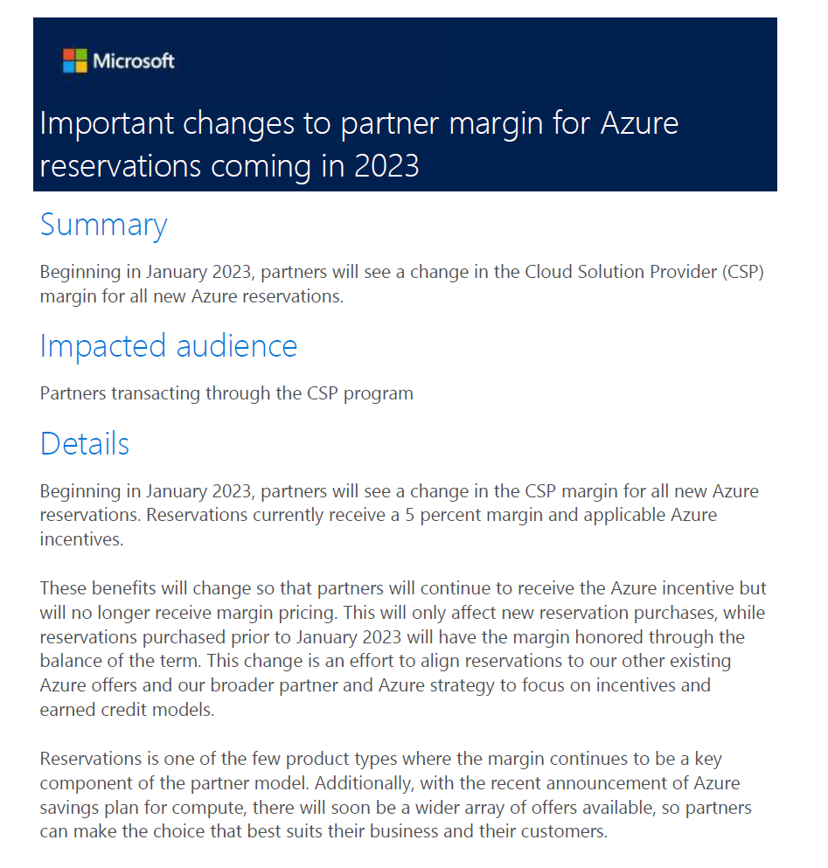
Azure RI (and SP) margins
Microsoft cutting RI margins to 0% (from 5%)
Reason: align w/ Direct customers – no on top discount for RIs there neither, even for largest customers
Either use contractual discount – OR higher RI and SP discounts – but not both.
High Incentives stay at 10% (reseller)

Slide 17
Q&A
Please raise your questions now!

Slide 18

Securing the Partner Ecosystem
Special Partner trainings: sign up here

Slide 19
Impact and consequences of Azure abuse
What is Azure abuse?
The CSP reseller provides a customer user Delegate Admin Privileges (DAP) to the CSP tenant – e.g. to setup new users for M365
In the current DAP model, (nearly) any Admin may also create new Azure VMs
Hackers gain access to customer login credentials
Hackers spin up Azure VMs to do crypto mining – and cause 100.000€ of Azure consumption in a few days…
99% of these cases could be avoided if customers would use basic security like MFA
  Microsoft policy
  The CSP partner is financially responsible for purchases by their customers and customers' nonpayment of purchased services. This includes fraudulent purchases.
    All partners in the Cloud Solution Provider program should have fraud prevention and detection risk mitigation controls in place.
    Review the published article that details our policy
We see still cases of Azure Fraud happening in Western Europe today!

Slide 20
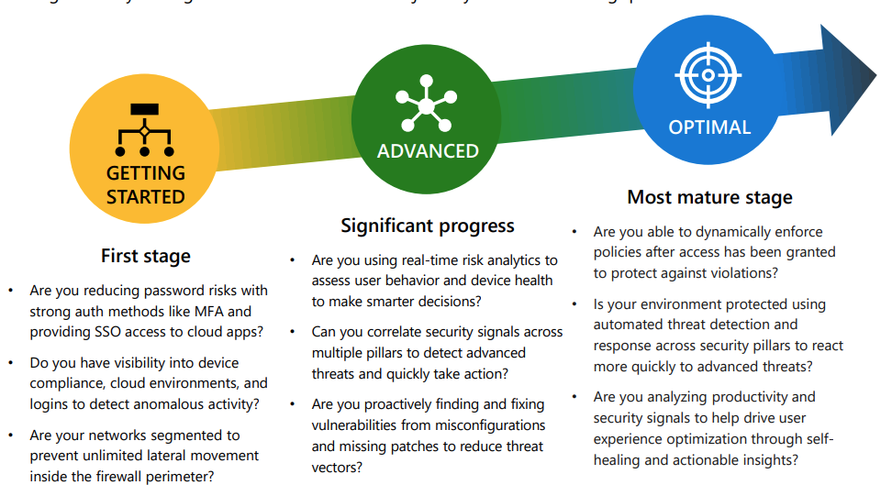
Zero Trust Model
Verify explicitly
Always make security decisions using all available data points, including identity, location, device health, resource, data classification, and anomalies.
Use least privilege access
Limit access with just-in-time and just-enough-access (JIT/JEA) and risk-based adaptive polices.
Assume breach
Minimize blast radius with micro-segmentation, end-to end encryption, continuous monitoring, and automated threat detection and response.
Notes:
Zero Trust is a proactive, integrated approach to security across all layers of the digital estate that explicitly and continuously verifies every transaction, asserts least privilege, and relies on intelligence, advanced detection, and real-time response to threats.
Security is not a one and done. It’s a journey through various levels of maturity.
The biggest rewards are already at the first stage. Did you know that MFA can block 99% of the threats?

Slide 21
Partner Best Practices:
5 things partners should know and do

Slide 22
Securing the Channel: Partner Best Practices
Learn More
Identify & Add Security Contacts
Secure your identity
Secure your endpoints
Ongoing Monitoring
Take the security courses
Watch the Inspire 2022 Session
Provide a security contact in Partner Center
(CSP partner tenant)
Enforce multifactor authentication (MFA) for all users and customer tenants
Remove delegated admin privileges (DAP) connections that are not needed or used
Transition active DAP connections to granular delegated (GDAP)
Use Microsoft Defender for Endpoint
Use Azure AD Conditional Access to enforce compliant devices
Utilize the information and guidance for:
Fraud detection
Cost management
Identity protection
Notes:
Speaker – Here is a list of 5 things partners can know and do. Following this overview are slides with links to resources.

Slide 23

1. Learn More
Take the security training courses!
Training courses
Three-part video series about implementing a zero-trust security architecture – Securing the Channel: Journey to Zero Trust training
Learning path – Control Azure spending and manage bills with Microsoft Cost Management and billing
Additional recommended content
Watch the Inspire 2022 Session – Adopting Zero Trust: Steps you can take to secure your Microsoft business
On the partner blog – Securing the channel: journey to zero trust
On the partner blog – Journey to Zero Trust: a proactive approach to securing your customers

Slide 24
2. Identify & Add Security Contacts
Provide a security contact in Partner Center for your
CSP partner tenant
Security contact responsibilities and guidance
All partners in the Cloud Solution Provider program should designate and add a security contact for their organization in Partner Center. This can be done by the partner’s global admin in Partner Center – it can’t be done through the APIs.
When any security related issue happens on a Cloud Solution Provider (CSP) partner tenant, Microsoft should be able to communicate the issue and recommend appropriate steps to a designated security contact in a partner organization who will act with urgency to mitigate and remediate security concerns as soon as possible.
The Cloud Solution Provider security contact:
    Must react when notified about a security incident
    We recommend using a Distribution List (vacation-proof)
    Inbox should be monitored 24/7
  Information about the security contact for partners

Slide 25

3. Secure your identity
Secure identities by enabling MFA and using GDAP
Enforce multifactor authentication (MFA) for all users in partner and customer tenants
Enable Azure Active Directory security defaults
Check and improve your identity secure score
Review best practices for Azure AD roles
Consider Azure Active Directory passwordless sign-in
Remove Inactive DAP (delegated admin privileges) connections
Check the DAP report and remove relationships
Delegated administration privileges (DAP) FAQ
Transition active DAP connections to GDAP (granular delegated admin privileges)
Granular delegated admin privileges (GDAP) introduction
GDAP bulk migration tool

Slide 26
Update on GDAP timeline
Action: Microsoft will no longer create DAP relationships when a new customer or reseller relationship is created. Partners will need to request GDAP Azure AD roles from customers to manage them.
Previously communicated date: January 17, 2023
Update: On February 15, 2023 Microsoft will provide further updates on when this activity will end.
Action: Microsoft will start transitioning inactive DAP relationships that have not been used in 90 or more days to GDAP. To review which relationships are inactive, please use the DAP monitoring report.
Previously communicated date: January 17, 2023
Update: On February 15, 2023, Microsoft will provide further updates on when this activity will begin.
Action: Microsoft will begin transitioning active DAP relationships to GDAP with limited Azure AD roles to perform least-privilege customer management activities. Partners should follow the guidance to continue to have access to Azure subscriptions after the limited roles are granted.
Previously communicated date: March 1, 2023
Update: On February 15, 2023, Microsoft will provide further updates on when this activity will begin.
Action: The bulk migration tool to upgrade existing DAP connections that were granted by customers to GDAP will no longer be available.
Previously communicated date: March 1, 2023
Update: On February 15, 2023 Microsoft will provide an update on when access to this tool will be ended.

Slide 27
4. Secure your endpoint
Secure and manage devices
Use Microsoft Defender for Endpoint
Devices accessing Partner Center and customers should be managed, secured, and monitored for risk.
Consider using Microsoft Defender for Endpoint:
  Watch the overview video
  Review the documentation
Use Azure AD Conditional Access to enforce compliant devices
Conditional Access – Require compliant or hybrid joined devices.
Consider a separate endpoint for accounts with customer tenant access.
Notes:
Other resources

Slide 28

5. Ongoing monitoring
Fraud detection information and guidance
Azure fraud detection and notification
Managing nonpayment, fraud, or misuse
Prevent unexpected growth in Azure spending due to misconfiguration or malicious activity
Cost management information and guidance
Cost Management + Billing – Microsoft Cost Management
Get started with Cost Management for partners
Set an Azure spending budget for customers
Monitor usage and spending with cost alerts in Cost Management
Identity protection information and guidance
Azure Active Directory Identity Protection notifications
Gain insights with customer activity logs
Notes:
Hand it over to Victoria

Slide 29
Recent Microsoft updates on the security side
Available Now
Azure subscription quota defaults have been lowered to align with current quota usage. Partners are able to cancel Azure subscriptions immediately. More details can be found in the December announcement.
On January 9, 2023, Microsoft enhanced the capabilities of detecting and notifying Azure fraud alerts.
Partners will be able to register a new webhook “azure-fraud-event-detected" Partner Center webhooks - Partner Center | Microsoft Learn.
The Partner Center Webhook APIs allow partners to register for resource change events.
These events are delivered in the form of HTTP POSTs to the partner's registered URL.
To receive an event from Partner Center, partners will host a callback where Partner Center can POST the resource change event.
The event will be digitally signed so that the partner can verify that it was sent from Partner Center.
Partners will now be able to see the Azure fraud events in the activity logs.
Partners can sign in to Partner Center and select the settings (gear) icon at top right corner and select Account settings.
They then can navigate to the Activity log and select an operation type: Azure Fraud Event Detected.
There, partners will be able to see the recent azure fraud alerts that are impacted.

Slide 30
Upcoming Microsoft updates on the security side
Launching by the end of January 2023
Partner security contacts can start receiving Azure fraud emails.
Today, emails are sent to the Admin Agents, but if the Admin Agent is JIT enabled and the JIT expires, the email will fail to deliver.
Hence, having a security contact will help detect and protect Azure fraud events.
To enable, a partner security contact should refer to the Cloud Solution Provider security contact
Starting February 15, 2023
Microsoft will be enhancing the existing Bulk Migration Tool to include the capability to remove DAP relationships by bulk.
Starting March 31, 2023
The Legacy Exchange Online Public Client ID (app ID a0c73c16-a7e3-4564-9a95-2bdf47383716) will be retired.
This public client ID is also known as the “ExO PowerShell” public client."
The legacy public client was previously used by the open-source Partner Center PowerShell module (github here).
Any code that incorporates either the legacy public client (a0c73c16-a7e3-4564-9a95-2bdf47383716) or the Partner Center PowerShell module will cease to function on March 31, 2023.

Slide 31
Q&A
Please raise your questions now!

Slide 32
Thank you

